Slide 1
SAS and Hadoop
how to use base SAS code
Prerequisites: Winscp, MobaXterm, Ambari connection, Hadoop connection
NOT: explanation of Hadoop ecosystem and its components eq. Big Data terminology.

Slide 2
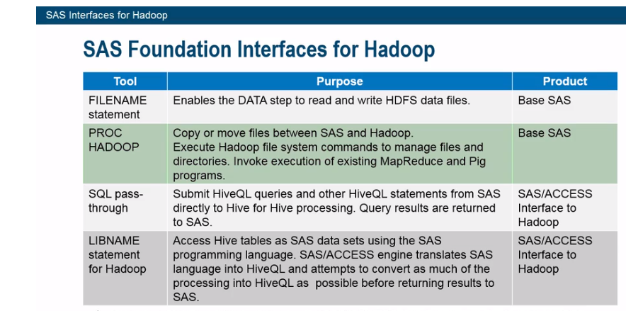

Slide 3
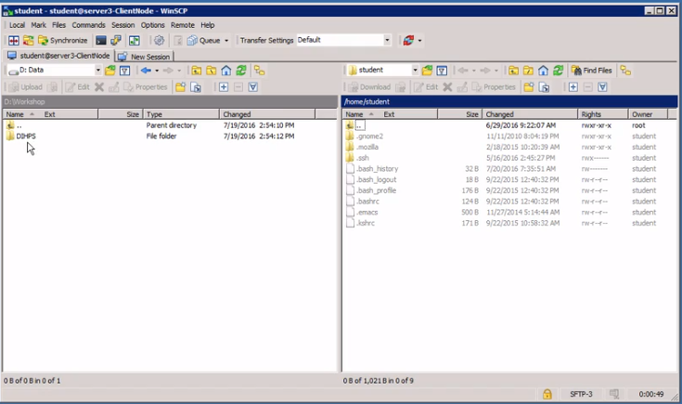

Slide 4
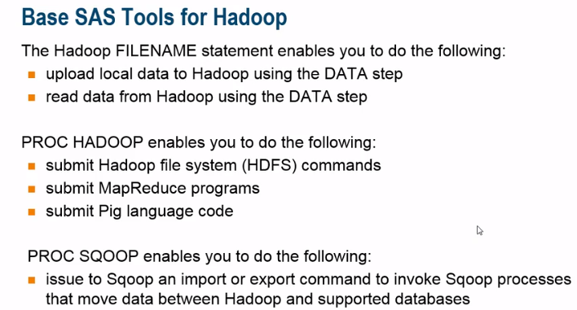

Slide 5
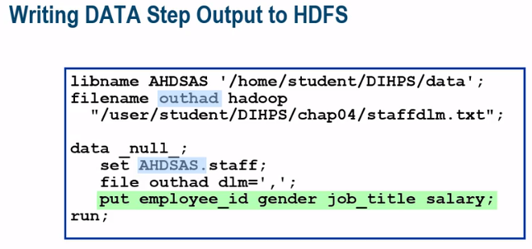
In this example, I'm going to write DATA out to HDFS from a SAS table, using SAS DATA Step. So first, I specify a libname of AHDSAS. And I'm pointing to a Linux operating system location /home/student/DIHPS/data. Then using the FILENAME statement, I specify a file reference. I'm using the keyword Hadoop, and I'm pointing to a file out in HDFS in /user/student/DIHPS/chap04/staffdlm.txt. That file resides in HDFS.

Slide 6
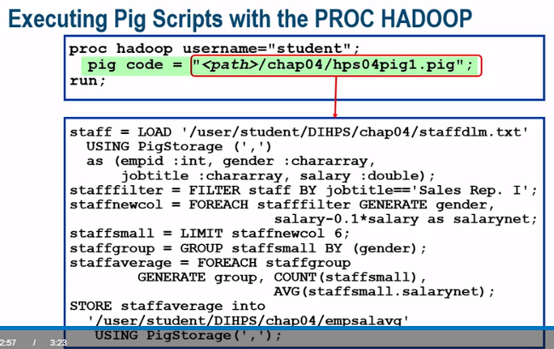
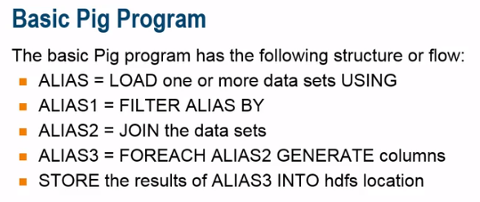
What Is Pig and Pig Latin?
So what is Pig? Well Pig is actually the data flow application for writing Hadoop operations using the language called Pig Latin. It's a layer of abstraction that sits on top of MapReduce as a high level programming language. SoMapReduce is written in Java, but Pig allows us to interface with MapReduce without having to learn how to write Java.
Pig is very SQL-like in how it's structured and operates on the data in Hadoop. What this allows the developer to do is to focus on business logic and increase productivity, because pig generates MapReduce, and the generatedMapReduce controls the job trackers and the task trackers. So the developer doesn't have to focus on that. They can just focus on the programming logic to perform the task at hand.
Pig was initially developed at Yahoo, and then given over to Apache since Hadoop is open source. So Apache Hadoop and Pig allow us to focus on analyzing large volumes of data and spend less time writing MapReduce programsin Java.
Pig was designed to handle a variety of types, because, as you know, you can store structured tables, such as database files; unstructured data, such as web blogs, tweets, video files out in Hadoop; and in semi-structured, whichwould be maybe an XML or an email file. Pig allows you to work against all these different types of data.
Who uses Pig? Well, since pig is really easy to understand, and once you understand what keywords and operators are out there, it's easily accessible for analysts to use, data scientists, and statisticians. Basically anybody thatunderstands SQL can use Pig, because they're very similar in language concepts and methodology.

Slide 7
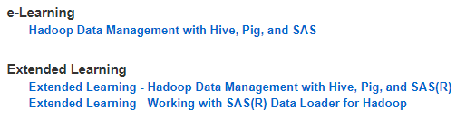
Next:
DS2 usage: DS2 is a new SAS proprietary programming language that is appropriate for advanced data manipulation. DS2 is included with Base SAS and SAS Viya and intersects with the SAS DATA step. It also includes additional data types, ANSI SQL types, programming structure elements, and user-defined methods and packages. It takes advantage of threaded processing in products such as the SAS In-Database Code Accelerator and SAS Enterprise Miner. It can createMethods and packages for easy deployment of reusable code modules.
Implementing Data Loader for Hadoop
Incorporating usage of Python/R into SAS
SAS courses
Check on Github: https://github.com/pimveeger/SAS-connecting-with-Hadoop

